Slide 1
Chapter 9: Main Memory

Slide 2
Chapter 9: Memory Management Strategies
Background
Contiguous Memory Allocation
Segmentation
Paging
Structure of the Page Table
Examples: the Intel 32 and 64-bit Architectures and ARM Architecture

Slide 3
Objectives
Explain the difference between a logical and a physical address and the role of the memory management unit (MMU) in address translation.
Dynamic storage-allocation problem - apply first-, best-, and worst-fit strategies for allocating memory contiguously.
Explain the distinction between internal and external fragmentation.
Translate logical to physical addresses in a paging system that includes a translation look-aside buffer (TLB).
Describe hierarchical paging, and hashed paging
Describe address translation for IA-32, x86-64, and ARMv8 architectures

Slide 4
Background
Main memory is central to the operation of a modern computer system.
Memory consists of a large array of bytes, each with its own address – byte-addressable
Program must be brought (from disk or secondary storage) into memory and placed within a process for it to run
A typical instruction-execution cycle include
CPU first fetches an instruction from memory (or cache)
The instruction is then decoded and may cause operands to be fetched from memory.
After the instruction executed on the operands, results may be stored back in memory.
The memory management unit or MMU only sees a stream of addresses
It does not know how they are generated, could be by the instruction counter, indexing, indirection, literal addresses, and so on or what they are for (instructions or data).
Accordingly, we are interested only in the sequence of memory addresses generated by a running program.

Slide 5
Background (Cont.)
Main memory (including cache) and registers are the only storage CPU can access directly; in another word, CPU cannot access secondary storage such as disk directly, but through I/O controllers
Memory management unit or MMU only sees a stream of addresses + read requests, or address + data and write requests
Registers can be accessed in one CPU clock (cycle)
Accessing main memory (through memory bus) may take many CPU clocks, causing a memory stall, when it does not yet have the data required to complete the instruction it is executing
Cache sits between main memory and CPU registers, residing on the CPU chip for fast access
Protection of memory required to ensure correct operation
We must protect the operating system from access by user processes, as well as protect user processes from one another.
This protection must be provided by the hardware for performance

Slide 6
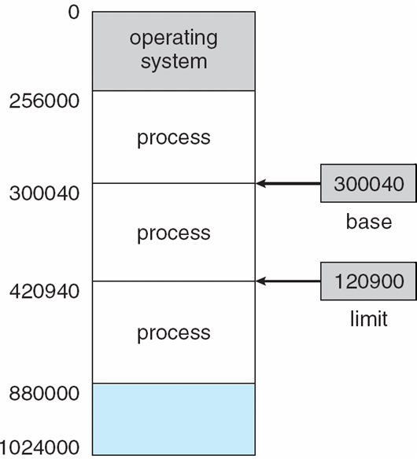
Per-process memory space separated from each other
Separate per-process memory space protecting the processes from each other is fundamental to have multiple processes loaded in memory for concurrent execution – multiprogramming system
A pair of base and limit registers define the legal range of a process address space
For example, if the base register holds 300040 and the limit register is 120900, then the program can legally access all addresses from 300040 through 420939 (inclusive)

Slide 7
Hardware Address Protection
Protection of memory space is accomplished by having CPU compare every address generated in user mode with these two registers
The base and limit registers can be loaded only by the operating system, which uses a special privileged instruction (executed only in the kernel mode)
The operating system, executing in kernel mode, however, is given unrestricted access to both operating-system memory and users' memory

Slide 8
Address Binding
Usually, a program resides on a disk as a binary executable file, which must be brought into memory and placed within a process (part of its address space) for it to run
Most systems allow a user process to reside in any part of the physical memory. Although the computer may start at 00000, the first address of a user process need not be 00000
A user program goes through several steps - some of which may be optional before being executed. Addresses may be represented in different ways during these step:
Source code addresses usually symbolic – the variable count
A compiler typically binds these symbolic addresses to relocatable addresses, such as “14 bytes from beginning of this module”
Linker or loader in turn binds the relocatable addresses to absolute addresses, i.e. 74014
Each binding is essentially a mapping from one address space to another

Slide 9
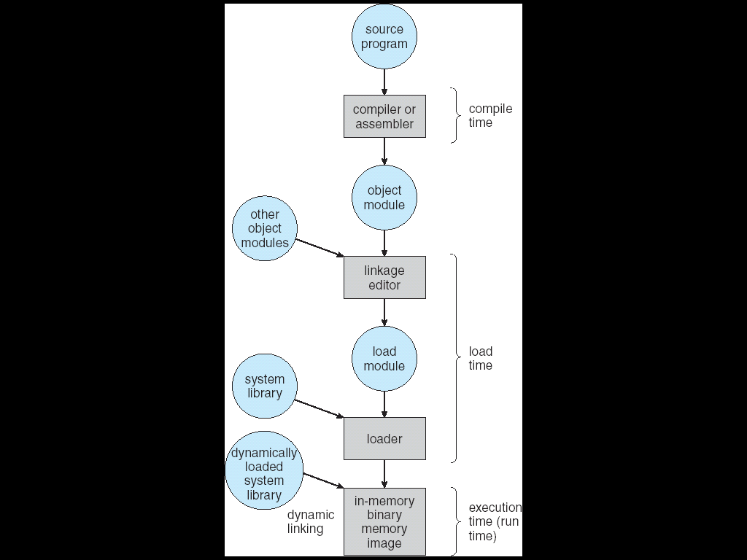
Multistep Processing of a User Program
Address binding of instructions and data to memory addresses can happen in three different stages
Compile time: If memory location is known a priori, absolute code can be generated; must recompile code if starting location changes (e.g., “gcc”). MS-DOS uses this
Link or Load time: Compiler must generate relocatable code if memory location is not known at compile time (e.g, Unix “ld” does link). The binding is delayed until load time. If the starting address changes, we need only reload the user code to incorporate this changed value
Execution time: Binding delayed until run time if the process can be moved during its execution from one memory segment to another. This needs hardware and operating system support for address maps (e.g., base and limit registers), e.g., dynamic libs. Most general-purpose operating systems use this method.

Slide 10
Address Translation and Protection
In the old days of uni-programming, only one program can run at the time, thus it occupies “nearly” the entire physical memory
No address translation is needed, nor is there any protection
In the earlier stage of multi-programming such as Windows 3.1 (1990-1992)
No address translation, binding occurs at link or loader time – address adjusted when programs are loaded into memory. Bugs in programs can crash the system
Protection was added later using base and limit registers, preventing illegal access by another user program

Slide 11
Logical vs. Physical Address Space
Recall: address space
All the addresses and space a process can “touch”
Each process has its own unique address space, different from kernel address space
Consequently, there are two views of memory
Logical address – generated by the CPU; also referred to as virtual address
Physical address – address seen by the memory
The translation is done by memory management unit or MMU – hardware device
Translation makes it much easier to implement protection
To ensure a process can not access another process’s address space.
Logical and physical addresses are the same if compile-time and load-time address-binding schemes are used (in old days); logical (virtual) and physical addresses differ only in execution-time address-binding scheme
Logical address space is the set of all logical addresses generated by a program
Physical address space is the set of all physical addresses generated by a program

Slide 12
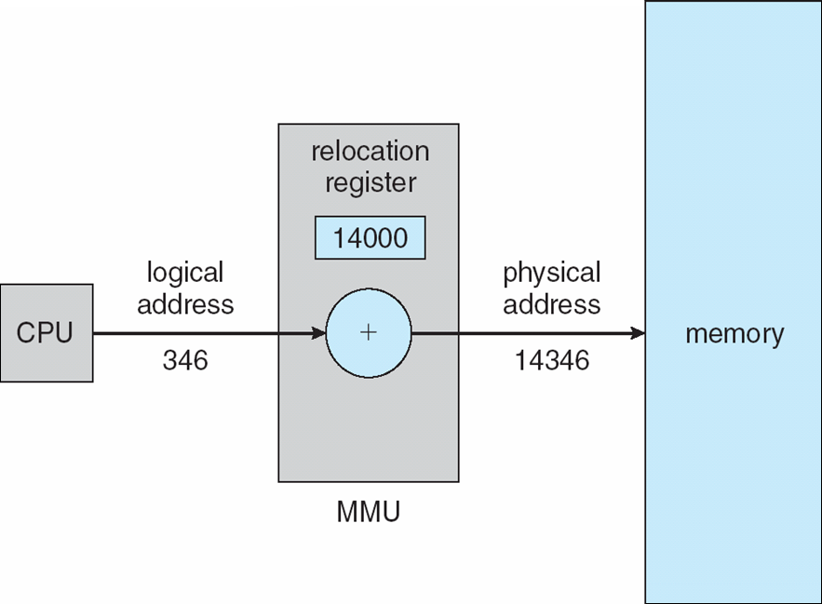
Memory-Management Unit (MMU)
MMU is a hardware mechanism that at runtime maps virtual address to physical address
There are many different mapping methods, covered in the rest of this chapter
To start, consider a simple scheme where the value in the relocation register is added to every address generated by a user process at the time it is sent to memory
User programs never accesses the real physical addresses
The user program deals with logical addresses; it never sees the real physical addresses
Execution-time binding occurs when reference is made to the actual location in memory

Slide 13
Contiguous Allocation
Contiguous allocation is one of the early memory allocation methods
Main memory is usually divided into two partitions – one for operating system and one for user processes
The operating system can be placed in either low memory addresses or high memory addresses, depending on many factors, such as the location of the interrupt vector
Many operating systems (including Linux and Windows) place the operating system in high memory
In a multi-programmed operating system, several user processes reside in memory at the same time. In contiguous memory allocation, each process contained in a single section of memory that is contiguous to the section containing the next process.

Slide 14

Hardware Support for Relocation and Limit Registers
Relocation register and limit register are used to protect user processes from each other, and from changing operating-system code and data
Relocation register contains value of the smallest physical address
Limit register contains range of logical addresses – each logical address must be less than the limit register
MMU maps logical address dynamically

Slide 15
Contiguous Allocation (Cont.)
Multiple-partition allocations
Degree of multiprogramming is bounded by number of partitions
Variable-partition sizes (sized to a given process’ needs)
Hole – block of available memory; holes of various size are scattered throughout memory
When a process arrives, it is allocated memory from a hole large enough to accommodate it
Process exiting frees its partition, adjacent free partitions combined
Operating system maintains information about: a) allocated partitions; b) free partitions (hole)
OS
OS
OS
OS
process 5
process 5
process 5
process 5
process 9
process 9
process 8
process 10
process 2
process 2
process 2
process 2

Slide 16
Dynamic Storage-Allocation Problem
How to satisfy a request of (variable) size n from a list of free holes?
First-fit: Allocate the first hole that is big enough
Best-fit: Allocate the smallest hole that is big enough
Must search entire list, unless ordered by size
Produces the smallest leftover hole – intended not use it
Worst-fit: Allocate the largest hole
Must also search entire list
Produces the largest leftover hole – intended to reuse the remaining hole
Experiments have shown that both first fit and best fit are better than worst fit in terms of decreasing time and storage utilization. Neither first fit nor best fit is clearly better than the other in terms of storage utilization, but first fit is generally faster.

Slide 17
Fragmentation
External Fragmentation – total memory space exists to satisfy a request, but it is not contiguous – scattered holes
The storage is fragmented into a large number of small holes.
Internal Fragmentation – memory allocated to a process may be larger than requested memory; this size difference is memory internal to a partition, but not being used

Slide 18
Fragmentation (Cont.)
Reduce external fragmentation by compaction
Shuffle memory contents to place all free memory together in one large block
Compaction is possible only if relocation is dynamic, and is done at execution time. In another word, if relocation is static and is done at assembly or load time, compaction cannot be done
The compaction is expensive (time-consuming)
The backing store has similar fragmentation problems, which will be discussed later
Another solution is to permit logical address space of the processes to be non-contiguous, by dividing into multiple pieces (variable-sized segments or fixed-size pages), thus allowing a process to be allocated physical memory wherever such memory is available. These techniques include Segmentation and Paging

Slide 19
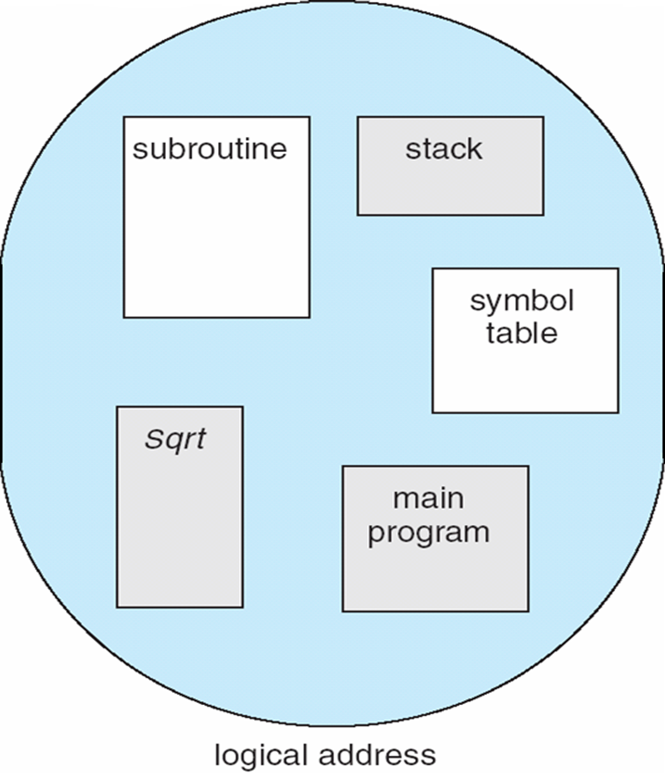
Segmentation- User View
Memory-management scheme that supports user view of memory
A program is a collection of segments. A segment is a logical unit such as:
main program
procedure
function
method
object
local variables, global variables
common block
stack
symbol table
arrays

Slide 20
Segmentation: Logical vs. Physical
1
1
4
2
3
4
2
3
user space
physical memory space

Slide 21
Segmentation Architecture
The Logical address now consists of a two-tuple:
<segment-number, offset>,
Segment table – maps two-dimensional programmer-defined addresses (virtual address) into one-dimensional physical addresses; each table entry has:
base – contains the starting physical address where the segments reside in memory
limit – specifies the length of the segment
Both STBR and STLR stored in the PCB of a process
Segment-table base register (STBR) points to the segment table’s location in memory
Segment-table length register (STLR) indicates the number of segments used by a program;
segment number s is legal if s < STLR

Slide 22
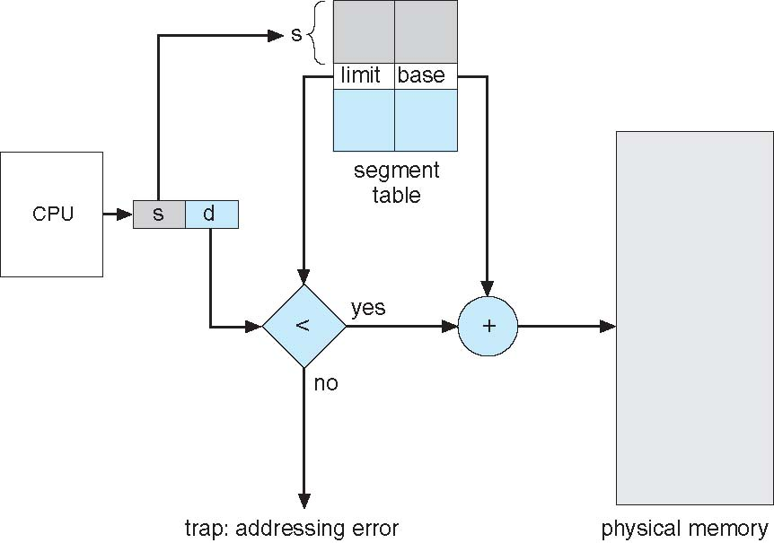
Segmentation Architecture (Cont.)
Protection. each entry in segment table associates with:
validation bit = 0 ⇒ illegal segment
read/write/execute privileges
A protection bit is associated with each segment; code sharing occurs at segment level
Since segments vary in length, memory allocation for a segment is a dynamic storage-allocation problem
External fragmentation still exists, but is much less severe than that in a contiguous allocation –since each segment is considerably smaller than the total memory space of a process

Slide 23
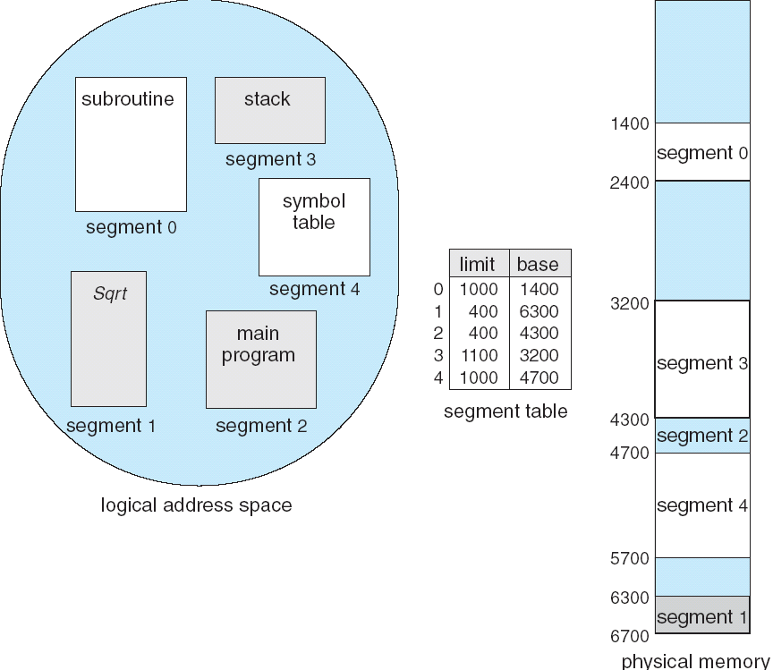
Example of Segmentation

Slide 24
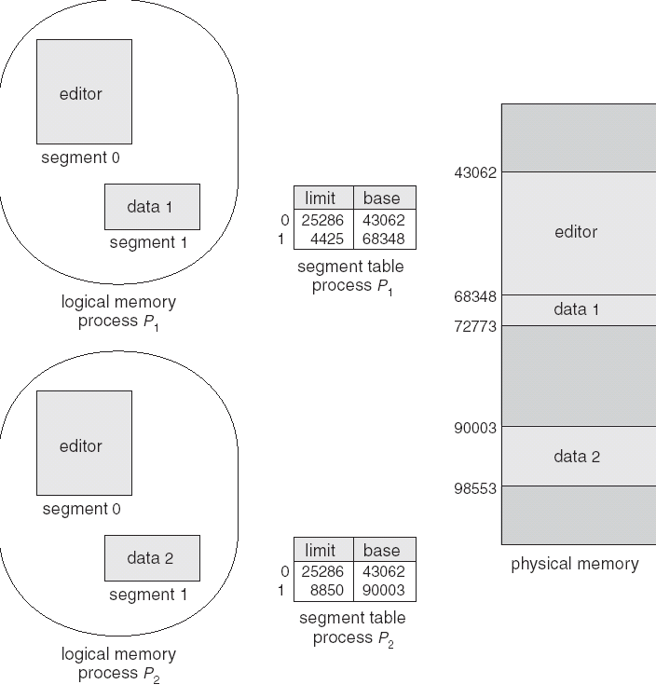
Sharing of Segments

Slide 25
Summary - Segmentation
Protection is easy in segmentation scheme – in segment table
Code segment would be read-only, data and stack would be read-write (stores allowed), shared segment could be read-only or read-write
Can address be outside the valid range?
Yes, this is how stack and heap are allowed to grow. For instance, stack takes fault, system automatically increases the size of stack
The main problem with segmentation
It must fit variable-sized chunks into physical memory – classical dynamic storage allocation problem
It may move processes multiple times to fit everything
External fragmentation

Slide 26
Paging
Physical address space of a process can be non-contiguous; process is allocated physical memory whenever the physical memory space is available
Avoids external fragmentation
Avoids the problem of varying sized memory chunks
Divide physical memory into fixed-sized blocks called frames
Usually the size is power of 2, between 4KB (12 bit offset) and 1 GB (30 bit offset) – defined by the hardware
Divide logical memory into blocks of same size called pages - the same size of a frame
The OS needs to keep track of all free (physical) frames available in main memory
To run a program of size N pages, need to find N free frames (non-contiguous) in memory and load the program into that
A page table is used to translate logical to physical addresses – keep track of allocated frames
This, however, suffers from internal fragmentation in the last page/frame

Slide 27
Address Translation Scheme
Address generated by CPU is divided into:
Page number (p) – used as an index into a page table which contains base address of each page in physical memory
Page offset (d) – combined with base address to define the physical memory address that is sent to the memory unit
Total m bits logical address, the logical address space 2^{m} bytes, and the page size is 2^{n}, the number of pages this logical address contains is 2^{m-n}
page number
page offset
p
d
m - n
n

Slide 28
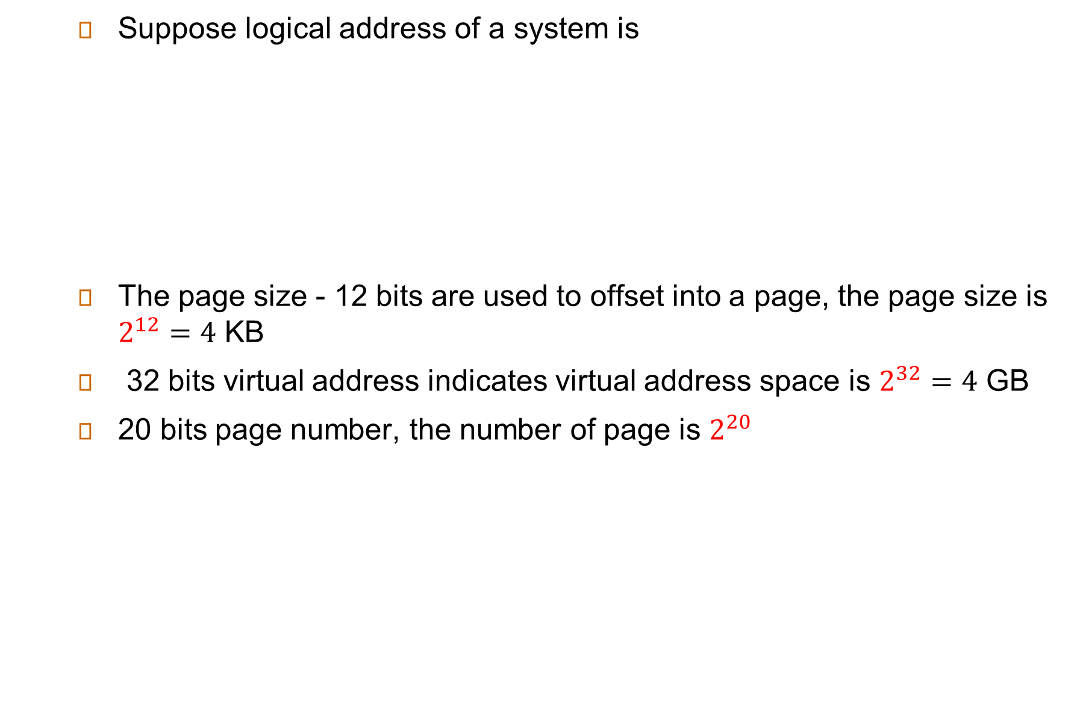
Example of Paging Scheme
page number
page offset
p
d
20-bit
12-bit

Slide 29
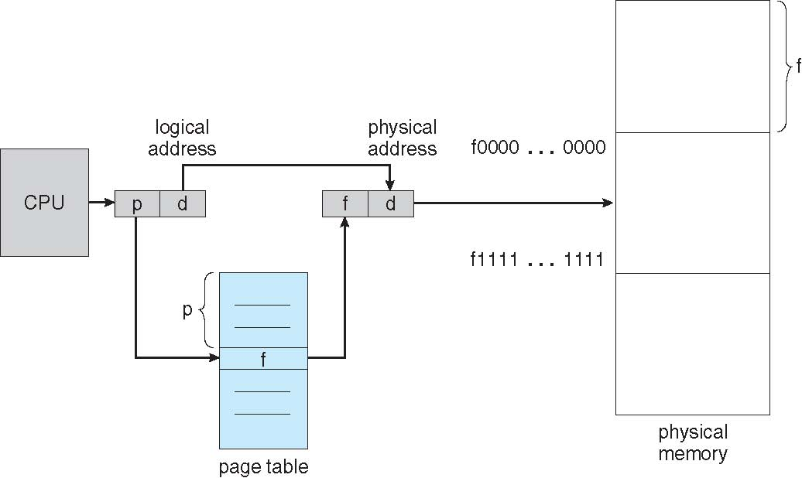
Paging Hardware
The following outlines the steps taken by the MMU to translate a logical address generated by the CPU to a physical address:
Extract the page number p and use it as an index into the page table.
Extract the corresponding frame number f from the page table.
Replace the page number p in the logical address with the frame number f
As the offset d does not change, it is not replaced, and the frame number and offset now comprise the physical address.

Slide 30

Paging Model of Logical and Physical Memory

Slide 31

Paging Example
m=4 represents logical address of 16 bytes
Logical address 0 is page 0, offset 0. Indexing into the page table, we find that page 0 is in frame 5. Thus, logical address 0 maps to physical address 20 [= (5×4) +0]
Logical address 3 (page 0, offset 3) maps to physical address 23 [= (5×4) + 3].
Logical address 4 is page 1, offset 0; according to the page table, page 1 is mapped to frame 6. Thus, logical address 4 maps to physical address 24 [= (6×4) + 0].
Logical address 13 maps to physical address 9.
n=2 and m=4 32-byte memory and 4-byte pages

Slide 32
Paging (Cont.)
Calculating internal fragmentation
Page size = 2,048 bytes (2KB)
Process size = 72,766 bytes
35 pages + 1,086 bytes
Internal fragmentation of 2,048 - 1,086 = 962 bytes
Worst case fragmentation = 1 frame – 1 byte
On average fragmentation = 1 / 2 frame size
So small frame sizes desirable?
The overhead involved in each page table entry reduces when page size increases.
Each page table entry takes memory to track, smaller page size leads to larger page table
Page sizes has grow over the time
Solaris supports two page sizes – 8 KB and 4 MB
Process view and physical memory now very different
The programmer views memory as one single space, containing only this one program. But in fact, user program is scattered throughout physical memory, which also holds other programs.

Slide 33

Free Frames
Before allocation
After allocation

Slide 34
Implementation of Page Table
Page table is kept in main memory
Page-table base register (PTBR) points to the page table (starting address)
Page-table length register (PTLR) indicates size of the page table
In this scheme every data/instruction access requires two memory accesses
One for the page table (translation) and one for fetching the data / instruction
The two memory access problem can be solved by the use of a special fast-lookup hardware cache called associative memory or translation look-aside buffers (TLBs)
TLBs typically small (64 to 1,024 entries). Some CPUs implement separate instruction and data address TLBs
On a TLB miss (if the page number is not in the TLB), value is loaded into the TLB for faster access next time. This can be done by hardware (MMU) or software (running kernel codes)
Replacement policies must be considered – LRU, round-robin or even random are possible
Some entries can be wired down for permanent fast access, for example TLB entries for key kernel code for fast access

Slide 35
Associative Memory
Associative memory (TLB) – parallel search
Address translation (p, d)
Check all entries in parallel (hardware)
If p is in associative register, get frame # out
Otherwise get frame # from page table in memory, and also bring this entry to the TLB
Locality on TLB
Instruction usually stays on the same page (sequential access nature)
Stack definitely has locality (pop in and out)
Data less locality, still quite a bit
Page #
Frame #

Slide 36

Paging Hardware With TLB

Slide 37
Effective Access Time
Associative Lookup = ε time unit
Usually < 10% of memory access time
Hit ratio = α
Hit ratio – percentage of times that a page number is found in the associative registers; ratio related to number of associative registers
Effective Access Time (EAT)
EAT = (1 + ε) α + (2 + ε)(1 – α)
= 2 + ε – α
Consider α = 80%, ε = 20ns for TLB search, 100ns for memory access
EAT = 0.80 x 120 + 0.20 x 220 = 140ns
Consider more realistic hit ratio -> α = 99%, ε = 20ns for TLB search, 100ns for memory access
EAT = 0.99 x 120 + 0.01 x 220 = 121ns

Slide 38
Memory Protection
Memory protection in paging is accomplished by protection bits associated with each frame. Normally, these bits are kept in the page table.
One bit can define a page to be read–write or read-only, or more bits to indicate execute-only
Valid-invalid bit attached to each entry in the page table:
“valid” indicates that the associated page is in the process’ logical address space
“invalid” indicates that the page is not in the process’ logical address space
The operating system sets this bit for each page to allow or disallow access to the page
Any violations result in a trap to the kernel
Example: a 14-bit address space (0 to 16383). If a program only uses address 0 to 10468, with a page size 2KB, pages 0-5 are valid, pages 6-7 are invalid.
Rarely does a process use all it address range, usually only a small fraction of the address space available. It would be wasteful to create a page table with entries for every page in the address range, and most of the table entries are unused but would take up memory space
use page-table length register (PTLR) to indicate the size of the page

Slide 39

Valid (v) or Invalid (i) Bit In A Page Table

Slide 40
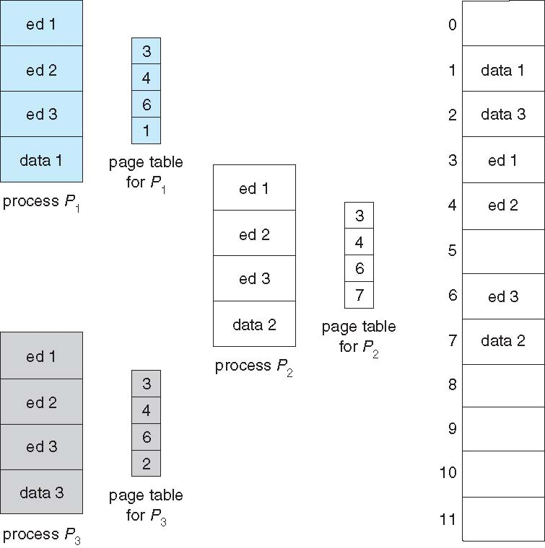
Shared Pages
Shared code
One copy of read-only (reentrant) code shared among processes (i.e., text editors, compilers, window systems)
Similar to multiple threads sharing the same process space
Also useful for interprocess communication if sharing of read-write pages is allowed
Private code and data
Each process keeps a separate copy of the code and data
The pages for the private code and data can appear anywhere in the logical address space

Slide 41
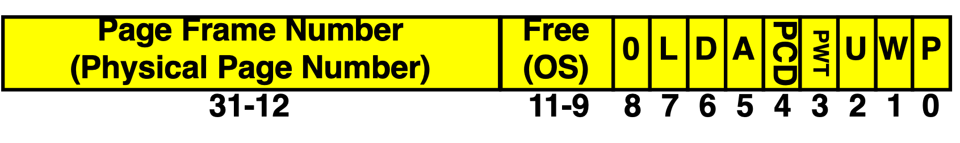
An Example: Intelx86 Page Table Entry
What is in a Page Table Entry or PTE?
For page translation, each page table consists of a number of PTEs
Permission bits: valid, read-only, read-write, write-only
Example: Intel x86 architecture PTE:
Address same format previous slide (10, 10, 12-bit offset)
Intermediate page tables called “Directories”
P: Present (same as “valid” bit in other architectures)
W: Writeable
U: User accessible
PWT: Page write transparent: external cache write-through
PCD: Page cache disabled (page cannot be cached)
A: Accessed: page has been accessed recently
D: Dirty (PTE only): page has been modified recently
L: L=1⇒4MB page (directory only). Bottom 22 bits of virtual address serve as offset within a page

Slide 42
Structure of the Page Table
Memory structures for paging can grow huge using straight-forward methods
Consider a 32-bit logical address space as on modern computers
Page size of 4 KB (2¹²)
Page table would have 1 million entries (2³² / 2¹²)
If each entry is 4 bytes -> 4 MB of physical address space / memory for page table alone
That amount of memory used to cost a lot
Page table cannot be allocated contiguously in main memory either, which will be allocated into multiple pages (frames) – paging the page table
Page size 4 MB (2²²) results in a page table with 1,000 entries, less of a problem
What about 64-bit logical address?
Hierarchical Paging
Hashed Page Tables

Slide 43
Hierarchical Page Tables
Break up the logical address space into multiple page tables
A simple technique is a two-level page table
To page the page table

Slide 44

Two-Level Page-Table Scheme

Slide 45
Two-Level Paging Example
A logical address (on 32-bit machine with 4K page size) is divided into:
a page number consisting of 20 bits
a page offset consisting of 12 bits
Since the page table is paged, the page number is further divided into:
a 10-bit page number
a 10-bit page offset
Thus, a logical address is as follows:
where p₁ is an index into the outer page table (in Intel architecture, this is called “directories”, and p₂ is the displacement within the page of the inner page table
because the address translation works from the outer page table inward, this scheme is also known as a forward-mapped page table
page number
page offset
p₁
p₂
d
10
10
12

Slide 46

Address-Translation Scheme

Slide 47
64-bit Logical Address Space
Even two-level paging scheme not sufficient
If page size is 4 KB (2¹²)
Then page table has 2⁵² entries
If two level scheme, inner page tables could be 2¹⁰ 4-byte entries
Address would look like
Outer page table has 2⁴² entries or 2⁴⁴ bytes
One solution is to add a 2nd outer page table
But in the following example the 2nd outer page table is still 2³⁴ bytes (16 GB) in size
And possibly 4 memory access to get to one physical memory location
The 64-bit UltraSPARC would require seven levels of paging – a prohibitive number of memory accesses – to translate each logical address
outer page
inner page
page offset
p₁
p₂
d
42
10
12

Slide 48


Three-level Paging Scheme

Slide 49

Hashed Page Tables
Common in address spaces > 32 bits
The virtual page number is hashed into a page table
This page table contains a chain of elements hashing to the same location
Each element contains (1) the virtual page number (2) the value of the mapped page frame (3) a pointer to the next element
Virtual page numbers are compared in this chain searching for a match
If a match is found, the corresponding physical frame is extracted

Slide 50
Example: The Intel 32 and 64-bit Architectures
Dominant industry chips
16-bit Intel 8086 (late 1970s) and 8088 was used in original IBM PC
Pentium CPUs are 32-bit and called IA-32 architecture
It supports both segmentation and paging - The CPU generates logical addresses, which are given to the segmentation unit. The segmentation unit produces a linear address for each logical address. The linear address is then given to the paging unit, which in turn generates the physical address in main memory.
Current Intel CPUs are 64-bit and called IA-64 architecture
Currently most popular PC operating systems run on Intel chips, including Windows, MacOS, and Linux (Linux runs on several architectures as well)
Intel’s dominance has not spread to mobile systems, where they mainly use ARM architecture
Many variations in the chips, cover the main ideas here

Slide 51
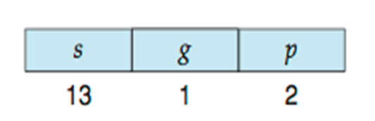
Example: The Intel IA-32 Architecture
Supports both segmentation and segmentation with paging
Each segment can be 4GB (32bits), up to 16K segments per process (14 bits), divided into two partitions
First partition of up to 8 K segments are private to process (kept in local descriptor table (LDT))
Second partition of up to 8K segments shared among all processes (kept in global descriptor table (GDT))
CPU generates logical address
Selector given to segmentation unit - which produces linear addresses – s for segment number, g indicates whether the segment is in LDT or GDT, p deals with protection
Linear address given to paging unit
Which generates physical address in main memory
Paging units form equivalent of MMU
Pages sizes can be 4 KB or 4 MB

Slide 52
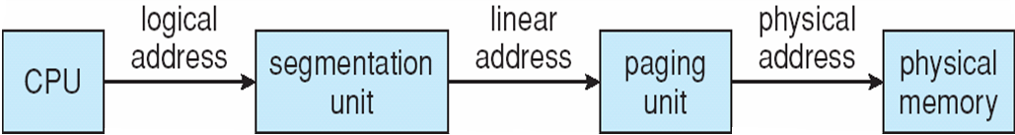
Intel IA-32 Segmentation
Each entry in the LDT and GDT consists of an 8-byte segment descriptor with detailed information about a particular segment, including the base location and limit
The segment register points to the appropriate entry in the LDT or GDT. The base and limit information about the segment is used to generate a linear address.

Slide 53
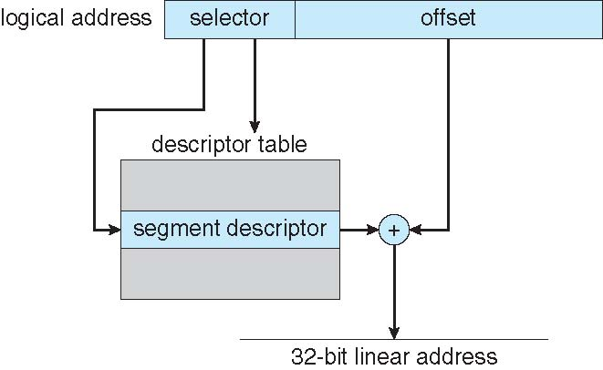
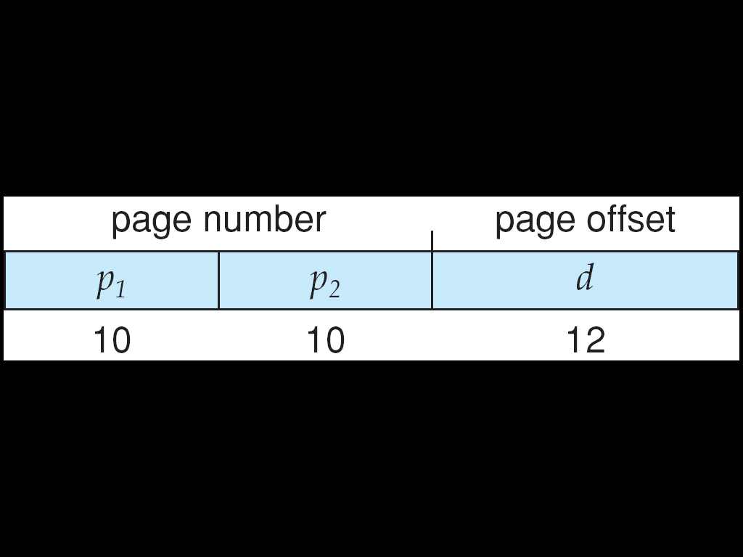
Intel IA-32 Segmentation
The linear address on the IA-32 is 32 bits long and is formed as follows
The limit is used to check for address validity. If the address is not valid, a memory fault is generated, trap to the operating system. If it is valid, the value of the offset is added to the value of the base, resulting in a 32-bit linear address.

Slide 54
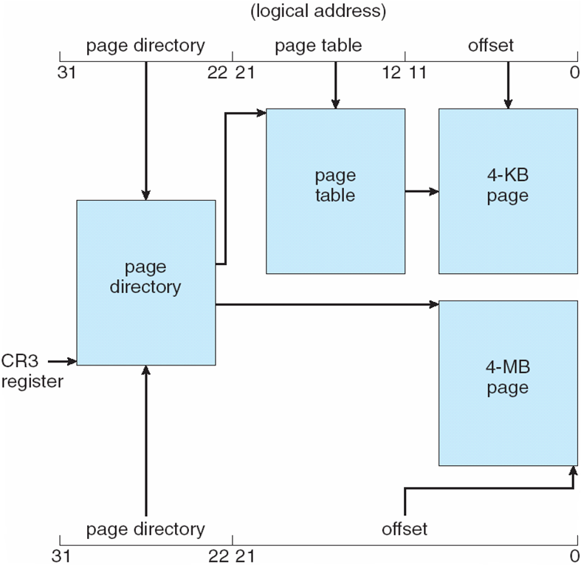
Intel IA-32 Paging Architecture

Slide 55
Intel x86-64
Current generation Intel x86-64 architecture
64 bits is ginormous (> 16 exabytes)
In practice only implement 48 bit addressing
Page sizes of 4 KB, 2 MB, 1 GB
Four levels of paging hierarchy
Can also use PAE (page address extension ) so virtual addresses are 48 bits and physical addresses are 52 bits (4096 terabytes)

Slide 56
Example: ARM Architecture
Dominant mobile platform chip (Apple iOS and Google Android devices for example)
Modern, energy efficient, 32-bit CPU
4 KB and 16 KB pages
1 MB and 16 MB pages (termed sections)
One-level paging for sections, two-level for smaller pages
Two levels of TLBs
Outer level has two micro TLBs (one data, one instruction)
Inner is single main TLB
First inner is checked, on miss outers are checked, and on miss page table walk performed by CPU

Slide 57
End of Chapter 9

